Slide 1

Entertainer Data Analytics
The media and industry is an essential part of our modern life, provided much-needed escape from the daily routine, stress and daily challenges. This industry compromises of different segments such as television, mobile phones, newspaper, radio etc. This segment produce content such as movies, TV shows, radio shows, music, magazines etc.
Mass media companies within this industry play a crucial role in managing the production, distribution and dissemination of several forms of media entertainment.

Slide 2
Entertainer Data Analytics
Details of Data:
Entertainer’s Name: This serves as a primary record of the dataset. It is a text data type.
Gender(traditional): This column specifies the gender of the entertainer. It is a text data type.
3. Birth Year: This column contains the birth year of the entertainer. It is Numeric data type.
4. Breakthrough Year: This column records the year when the entertainer got recognition.
5. Breakthrough Name: This column contains the name of the album/movie/song that led entertainer breakthrough.
6. Year of first Oscar/Grammy/Emmy: This column indicates the year when the entertainer received their first major industry award, such as an Oscar or Grammy.
7. Year of last major work: This column records the year of the entertainer's last significant work or major contribution to their field.

Slide 3
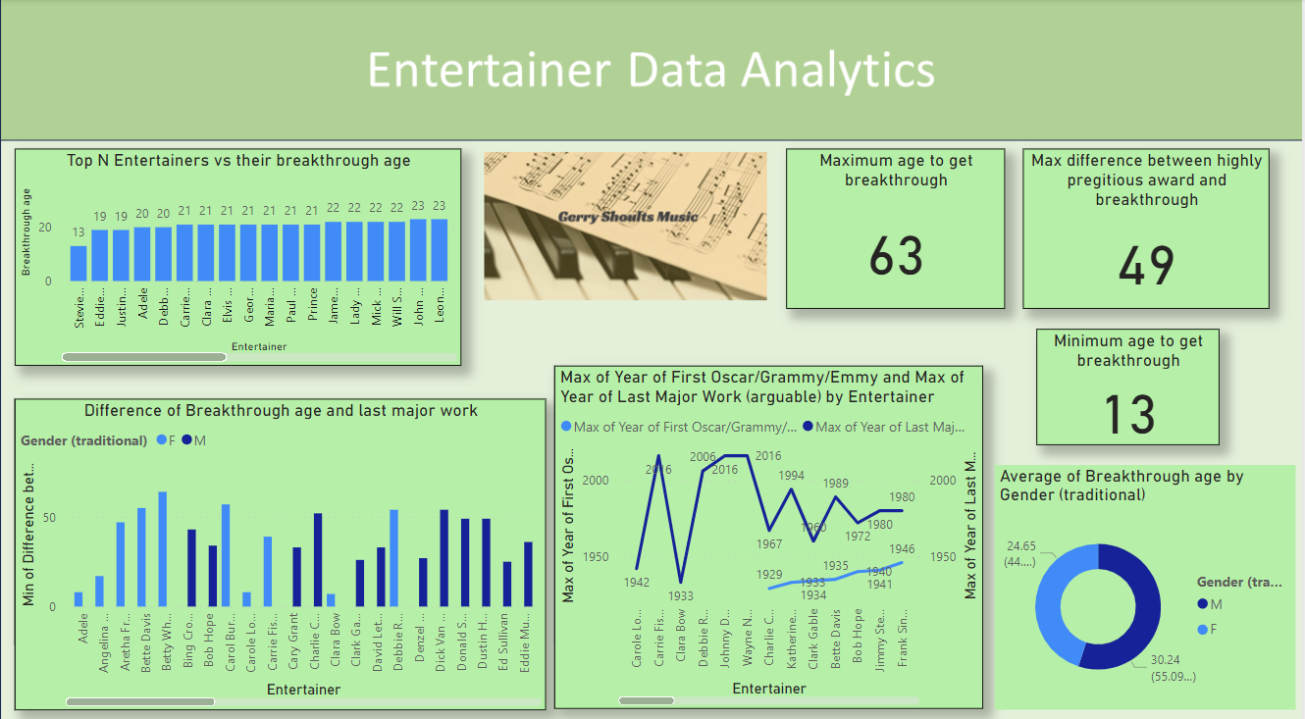
Entertainer Data Analytics

Slide 4

Entertainer Data Analytics
Key
Performance
Indicators
Age at Breakthrough: The age at which an entertainer achieved the major success.
Career longevity: The span of an entertainer’s active career from breakthrough to their last major work.
Time to receive major award: Time taken from breakthrough to winning the highly prestigious award.

Slide 5

Entertainer Data Analytics
The youngest entertainer is Stevie Wonder and got breakthrough at the age of 13.
The oldest entertainer who got breakthrough at the age of 63.
The maximum difference between highly prestigious award(Oscar/grammy/emmy) and Breakthrough is 49.
The average age of male of breakthrough is approximately 24 years.
Adele the entertainer got breakthrough at the age of 20 years and she did her last work as an entertainer at the age of 28 years.

Slide 6
Entertainer Data Analytics
Thank you!

